Slide 1
WEB APPLICATION DEVELOPMENT
PROGRAMMING

Slide 2
UT11. External Structures: Files.
Files.
File systems.
2. Opening and closing files. Writing and reading information in files.
3. Access modes.
4. Storage of objects in files.

Slide 3
Files.
Until now we have always worked in RAM memory, but if we want the information obtained from a program not to be lost, it must be stored in a secondary memory (pendrive, hard disk, etc.). To be able to do this it is necessary to use files or databases.
A FILE is a grouping of a series of data, all of the same type.
Each piece of data stored in a file is called a RECORD.
A record is, in turn, made up of one or more data that can be of different types. Each piece of data contained in the record is called a FIELD.

Slide 4
Files.
EXAMPLES:
A file with information about all the students in a class. The set of all the data of a student is the record, i.e. there is one record per student. Each of the data (name, age, ....) we are interested in about a student is called a field.
A file with information on all the customers of a bank. The set of all data of a client is the record, i.e. there is one record per client. Each of the data (name, balance, ....) we are interested in about a customer is called a field.
The size of a file is variable, since it can increase or decrease as records are inserted or deleted.

Slide 5
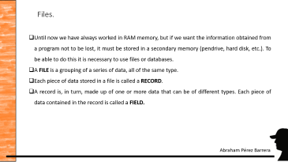
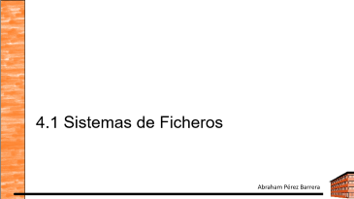
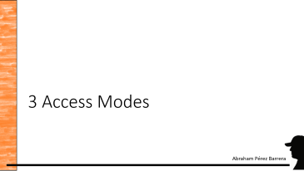

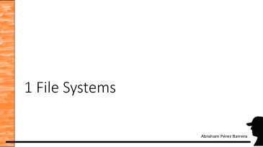
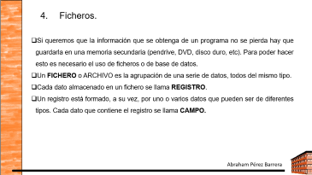
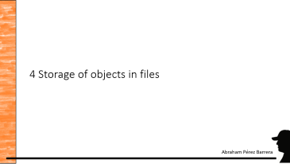

Slide 6
1 File Systems

Slide 7
File systems.
As the access to perform input/output is device independent, we need some means to access the file system.
For this purpose Java provides us with the File class. This class gives us access to the file system and allows us to build input/output streams for data in both bytes and characters.
The File class gives us access to the file system, independently of the operating system on which it is executed.
Thanks to the File class, which has the Java API, we can obtain important information about the file we are going to work with, such as its path, if it is a file or a directory, size, last modification, etc. It also allows us to change the name of the file, delete it, etc.
The File class does NOT allow access to the information contained in the file itself, for that we have other classes. It does not allow us to read or write to the file

Slide 8
File systems.
The File class contains three possible constructors:
File (String path): receives in the object instantiation the complete path where the file is along with the name.
By default, if no path is specified, it will look for it in the base folder of the project.
Also, path can be the path to a directory, without indicating the name of any file.
File (String path, String nomFiche): receives in the object instantiation the complete path where the file is as first parameter and the file name as second parameter.
File (File path, String nomFiche): receives in the object instantiation an object of type File, which refers to a directory as first parameter and the file name as second parameter.

Slide 9
File systems.
Some methods of the File class that are useful for files and directories are:
boolean canRead( ): returns true if the information it contains can be read.
boolean canWrite( ): returns true if it can be written to.
boolean exists( ): returns true if the file or directory exists.
boolean isFile( ): informs whether it is a file or not.
long lastModified( ): returns the date of the last modification.

Slide 10
File systems.
Some of the methods that the File class has, which are only useful for files, are:
delete( ): deletes the file.
long length( ): returns the size of the file in bytes.
renameTo(File new): rename the file.
Some of the methods that the File class has, which are only useful for directories, are:
boolean mkdir( ): creates a directory.
String [] list( ): returns a list of the files in the directory.

Slide 11
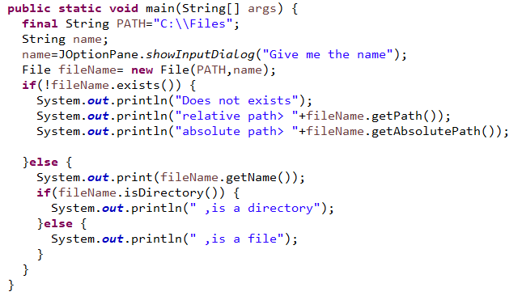
File systems.
Exercise 1: We ask the user to enter the name of a file or a directory and show on the screen if the file or directory exists or not. Also, show whether it is a file or a directory.

Slide 12
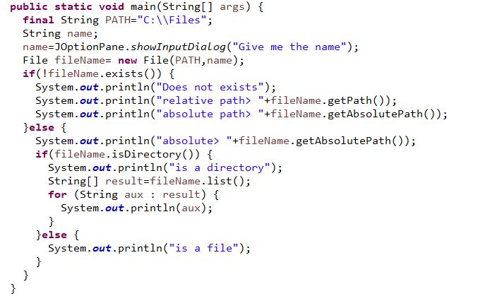
File systems.
Exercise 2: We list the contents of the current directory, files and directories ("." refers to the current directory). The list method returns the list of directories and files, which is stored in the string array "list". Then we traverse the array to display them.

Slide 13
File systems.
When writing the path to a file or directory, the treatment in Windows and Linux is different: the separator in Linux is "/" and in Windows "\".
In addition, as in Windows "\" is an escape sequence, in the path we have to duplicate the separator. For example, to open a file whose path is "C:\miarchivo.txt", we would have to write
File file = new File ("C:\miarchivo.txt");

Slide 14
File systems.
Activity 3: write a program that asks for the name of a file and checks if it is in the current directory. The program will continue to ask for filenames as long as you do not tell it otherwise.
Activity 4: write a program that lists the current directory, indicating in front of each file and directory whether it is a file or a directory.

Slide 15
2. Opening and closing files

Slide 16
2. Opening and closing files. Classes for writing and reading information in files.
2.1 FileInputStream
2.2 FileOutputStream
2.3 FileReader
2.4 FileWriter
2.5 Scanner
2.6 Use of BufferedReader and BufferedWriter Buffers
2.7 DataInputStream and DataOutputStream

Slide 17
2. Opening and closing files. Writing and reading information in files.
Java has several classes that allow file handling within the Java.io package.
The basic classes are:
FileInputStream and FileOutputStream that allow reading and writing, respectively, bytes to files.
FileReader and FileWriter if we are going to work with text files, therefore they allow to read and write, respectively, characters in the files.

Slide 18
2.1 FileInputStream class.
The FileInputStream class allows us to create a read stream to a file to read bytes from it.
When we instantiate an object with this type of class, what the program does is to open the file, which is sent as an argument, for reading. Once opened, the information it contains can be read sequentially byte by byte.
This class provides different constructors:
FileInputStream(String nomFich): path or file name.
FileInputStream(File fich): name of the file we want to work with.

Slide 19
2.1 FileInputStream class.
These constructors throw the FileNotFoundException error if such a file does not exist.
The main methods of this class are:
int read(): returns the ASCII code of the next byte after the file pointer. This pointer moves sequentially through the file, as we read the bytes. It returns -1 if there is no more byte to read.
void close(): closes the file and releases the associated resources.

Slide 20
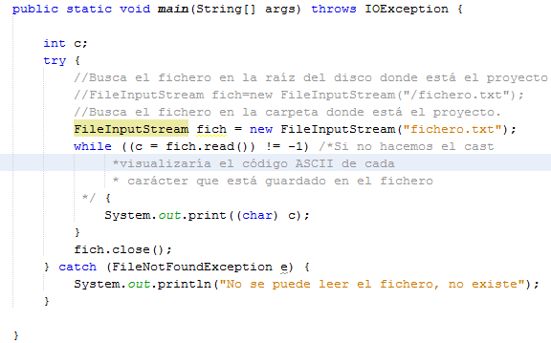
2.1 FileInputStream class.
Activity 5: Using the FileInputStream class we are going to read the content of a file. Steps to follow: open a file named "file.txt", read it byte by byte until the end of the file is reached (when it returns -1) and display it on the screen. Then close the file.

Slide 21
2.2 FileOutputStream class.
The FileOutputStream class allows us to create a write stream to a file to write bytes to it.
When we instantiate an object with this type of class, what the program does is to open the file that is sent as argument for writing.
Once opened, information can be stored byte by by byte.
If the file did not exist, I would create it.

Slide 22
2.2 FileOutputStream class.
The builders are:
FileOutputStream(File file file).
FileOutputStream(String name).
FileOutputStream(File file file, boolean add)
FileOutputStream(String name, boolean add)
The first two delete the contents of the file if any, the last two, if append is true, append whatever is written to the end of the file.
All of them, if the file does not exist, create it.

Slide 23
2.2 FileOutputStream class.
The main methods are:
int write(int byte): writes the byte received as argument to the file.
void close(): closes the file.

Slide 24
2.2 FileOutputStream class.
Activity 6: Write a program that inserts a sentence and writes it to a file. Then, read the sentence from the file and print it to the screen. When you run the program several times, only the last inserted sentence should be output.

Slide 25
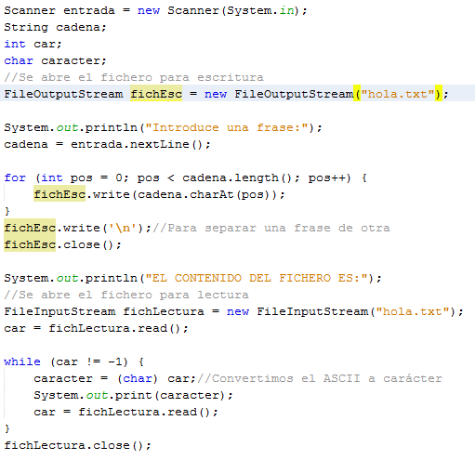
2.2 FileOutputStream class.
After the exercise has been completed, modify it so that all the sentences that are inserted are displayed on the screen, not only the last one.

Slide 26
2.2 FileOutputStream class.
Activity 7: Write a program that prompts for a character on the keyboard and counts the number of times it appears in a file.
Activity 8: Write a program that asks for the name of two files and tells us if they are the same (have the same content).
Activity 9: Write a program that creates a copy of a file.
Activity 10: View the information in the two files in order to verify that they contain the same information.

Slide 27
2.3 FileReader Class
When we instantiate an object with this type of class, what the program does is to open the file, which is sent as an argument, for reading. Once opened, the information it contains can be read sequentially character by character.
As with the FileInputStream class, if the file does not exist, it throws the java.io.FileNotFoundException.
The methods of this class are very similar to those of the FileInputStream class, the ones we are going to use are the same as the ones already seen with this class: read () to read from it and close() to close the file. DO NOT FORGET TO CLOSE THE FILE

Slide 28
2.4 FileWriter Class
Opens a file in order to be able to store information, but this time, character by character. If the file does not exist, it creates it.
If the file we want to open already exists, we have two possibilities:
Start from the beginning, deleting the information it contains. To do this, the object must be instantiated in this way:
FileWriter fich=new FileWriter("fileName");
Add the new information at the end of what is contained in the file. To do this, the object must be instantiated in this way:
FileWriter fich=new FileWriter("filename",true);
The methods of this class are very similar to those of the FileOutputStream class, the ones we are going to use are the same as the ones already seen with this class.

Slide 29
2.4 FileWriter Class
To write to the file we will use the write method in any of its variants. Some of them are:
The one that admits a character as argument (its ASCII code is indicated): public void write(int c). Example: file.write(97);
The one that admits a string as argument: public void write(String string). Example: file.write("This is a string");
The one that admits as argument a portion of a string (the string, the position from which to start reading and the number of characters are indicated): public void write(String string, int start, int length). Example: file.write("This is a string", 5, 17);

Slide 30
2.4 FileWriter Class
Activity 11: Using the FileReader and FileWriter classes, we write a string and a character to a file. Then, we open the file and display its contents on the screen:
The read method returns an integer that we convert to a character by casting. -1 indicates the end of the file.
FileWriter fich=new FileWriter("fileName");
fich.write("This is a string");

Slide 31
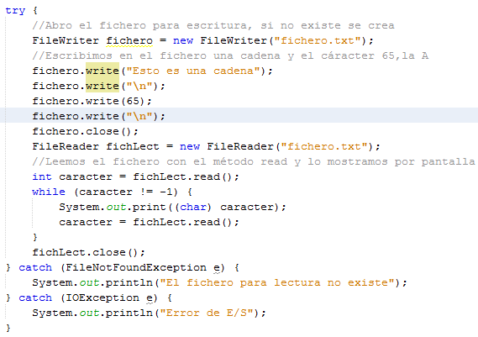
2.4 FileWriter Class
Activity 12: Using the FileReader and FileWriter classes, we write a string and a character to a file. Then, we open the file and display its contents on the screen:
The read method returns an integer that we convert to a character by casting. -1 indicates the end of the file.

Slide 32
2.4 FileWriter Class
Activity 13: Write a program that asks for strings by keyboard and saves them in a file using the FileWriter class. Then the contents of the file will be displayed using the FileReader class. How would you modify the program so that the new sentences are added to the already saved ones?
Activity 14: Write a program that makes a copy of the file from the previous activity using the FileReader and FileWriter classes.

Slide 33
2.5 Scanner Class
Since Java version 5, you can read a text file using the Scanner class in the same way as if you were reading by keyboard.
To do this, the File object associated with the file is passed to the Scanner constructor.
Throws a FileNotFoundException if the file does not exist.
The hasNext() method of the Scanner class is used to know if there is more data to read in the file.

Slide 34
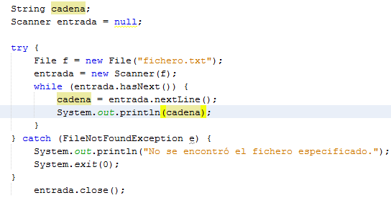
2.5 Scanner Class
Activity 15: Using the Scanner class, open a file and display each line of the file.

Slide 35
2.6 Use of Buffers
With the classes we have seen so far FileInputStream, FileOutputStream, FileReader or FileWriter, the bytes or characters are read or sent one by one, which makes this task slow.
The use of intermediate buffers makes these tasks faster.
The use of buffers is done with classes such as BufferedReader, BufferedInputStream, BufferedWriter and BufferedOutputStream.

Slide 36
2.6 Use of Buffers
To instantiate an object of the BufferedReader class it is necessary to first instantiate an object of the FileReader class.
FileReader lector=new FileReader("C:\FileReader1.txt");
BufferedReader lectorBuffer= new BufferedReader(lector);

Slide 37
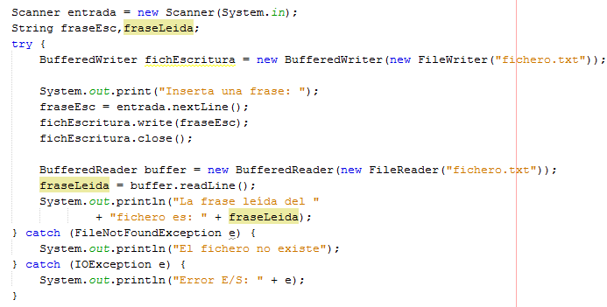
2.6 Use of Buffers.
Activity 16: We request a string by keyboard and save it in the file. Then we read it and display it on the screen.

Slide 38
2.6 Use of Buffers
Activity 17: Write a program that asks for strings by keyboard and saves them in a file using the BufferedWriter class. Then the content of the file will be displayed using the BufferedReader class and the number of lines in the file.
Activity 18: Write a program that initializes three vectors with the data of a series of students. In one vector, we are going to store their names; in another one, the age of each student, and in the last one, the grade with decimals that each student has obtained in the Programming module. Subsequently, you will save this data in a file. After saving the data, we open the file to read them and display them on the screen.

Slide 39
2.6 Use of Buffers
In the same way; to instantiate an object of the BufferedWriter class it is necessary to first instantiate an object of the FileWriter class.
FileReader lector=new FileReader("C:\FileReader1.txt");
BufferedReader lectorBuffer= new BufferedReader(lector);

Slide 40
2.6 Use of Buffers
The BufferedWriter class has a method write(int c) to write a single character and another to write a part of a string (write(String string, int start, int length)).
The BufferedReader class has a read() method that reads a character, a readLine() method that reads a line, a read(char[] cbuf, int start, int length) method that reads a part of a character array.

Slide 41
2.7 DataInputStream and DataOutputStream
Other classes for reading and writing to files are the DataOutputStream and DataInputStream classes.
When accessing a file using these classes, we can use more methods for input and output than with the FileOutputStream and FileInputStream classes.

Slide 42
2.7 DataInputStream and DataOutputStream
To open a file for writing using the DataOutputStream class, it would be:
FileOutputStream file=new FileOutputStream("test.txt");
DataOutputStream output=new DataOutputStream(file);
Or in a single line:
DataOutputStream output=new DataOutputStream(new FileOutputStream("test.txt"));

Slide 43
2.7 DataInputStream and DataOutputStream
To open a file for reading with DataInputStream:
FileInputStream file=new FileInputStream("test.txt");
DataInputStream input=new DataInputStream(file);
Or in a single line:
DataInputStream input=new DataInputStream(new FileInputStream("test.txt"));

Slide 44
2.7 DataInputStream and DataOutputStream
Some of the methods of DataInputStream are variations of the read method of the base class for the different data types are:
boolean readBoolean(),
byte readByte(),
int readUnsignedByte(),
short readShort(),
int readUnsignedShort(),
char readChar(),
int readInt(),
String readLine(),
long readLong(),
float readFloat(),
double readDouble(),...

Slide 45
2.7 DataInputStream and DataOutputStream
On the other hand, the DataOutputStream class defines several write methods that are variations of the write method of the base class to write primitive data.
void writeBoolean(boolean v),
void writeByte(int v),
void writeBytes(String s),
void writeShort(int v),
void writeChars (String s),
void writeChar(int v),
void writeInt(int v),
void writeLong(long v),
void writeFloat(float v),
void writeDouble(double v),

Slide 46
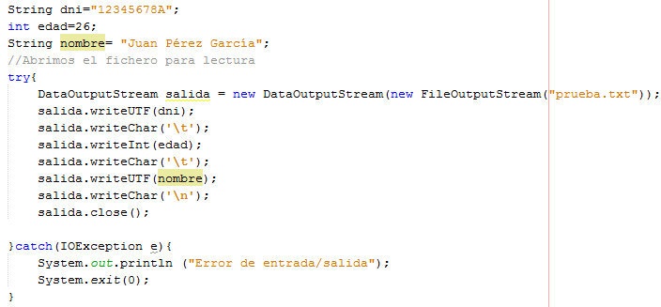
2.7 DataInputStream and DataOutputStream
Activity 19: We save in the file "test.txt" the ID, age and name of a person using the methods writeUTF(), writeChar() and writeInt().

Slide 47
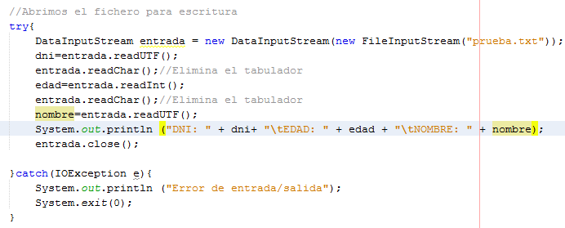

2.7 DataInputStream and DataOutputStream
We open the above file for reading and display the contents on the screen using the readUTF(), readChar() and readInt() methods;
The output per screen is:

Slide 48
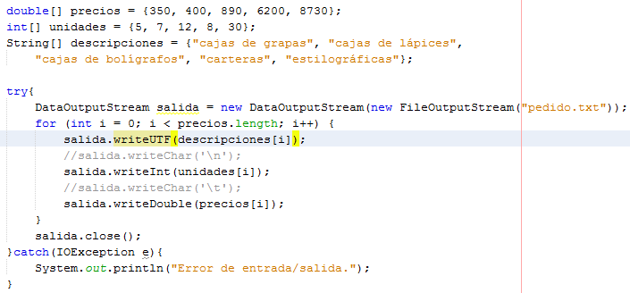
2.7 DataInputStream and DataOutputStream
Activity 20: To save the data of an order in a file, we have the following code fragment:

Slide 49
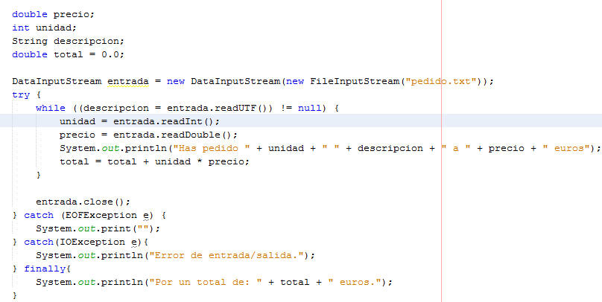
2.7 DataInputStream and DataOutputStream
After saving the data, we open the file to read it and display it on the screen with the following code fragment:

Slide 50
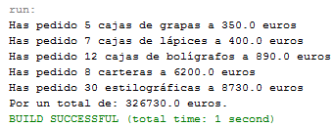
2.7 DataInputStream and DataOutputStream
The program produces the following output:

Slide 51
3 Access Modes

Slide 52
3 ACCESS MODES
Access to the information in a file is done sequentially or randomly.
Sequential access involves traversing the file from the beginning in order to get to the data you are looking for.
Random access allows accessing a data directly by indicating the position in which it is located.
In order to be able to perform random access, the file must be organized in such a way as to allow this type of access.

Slide 53
3 ACCESS MODES
All the classes we have seen in the examples and activities were for accessing the file sequentially.
If we are looking for direct access to a piece of data without going through the rest, we have the RandomAccessFile class.

Slide 54
3 ACCESS MODES
The files handled by this class are binary and allow access through an index to the data we are interested in.
We have two ways to open a file for random access (one for each type of constructor of the class):
RandomAccessFile f=new RandomAccessFile(String path, String mode)
RandomAccessFile f=new RandomAccessFile(File file file, String mode)

Slide 55
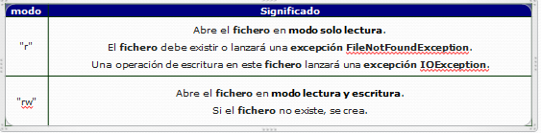
3 ACCESS MODES
The possible values for "mode" are "r" and "rw".
The meaning of each one can be seen in the following table:
The first example opens the file "pedidos.dat" for reading and the second for writing:
RandomAccessFile file=new RandomAccessFile("orders.dat", "r");
RandomAccessFile file=new RandomAccessFile("orders.dat", "rw");

Slide 56
3 ACCESS MODES
Since it implements the DataInput and DataOutput interfaces, we can use all the read and write methods of the DataInputStream and DataOutputStream classes that we already know.
In addition, it has some methods to move through the file that are:
long getFilePointer(): returns the current position of the file pointer. It indicates the position (in bytes) where it is going to be read or written.
long length(): returns the length of the file in bytes.

Slide 57
3 ACCESS MODES
void seek(long pos): places the file pointer at a given position (pos). The position is given as an offset in bytes from the beginning of the file. Position 0 indicates the beginning of the file. The position length() indicates the end of the file.
int skipbytes(int d): moves the file pointer (from its current position) as many bytes as specified in the argument.

Slide 58
3 ACCESS MODES
Activity 21: We open a file for writing and we write the names that are inserted by keyboard at the end of the file. Then we open it and read the content from the beginning.
(Code on the next slide)

Slide 59
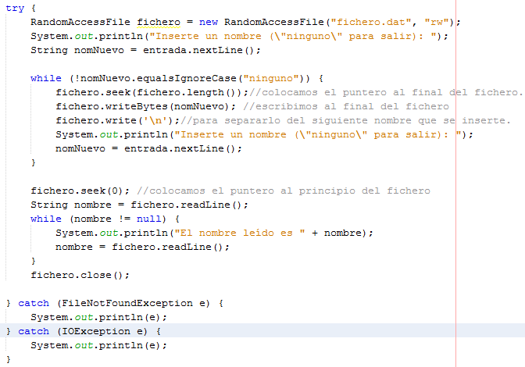
3 ACCESS MODES

Slide 60
4 Storage of objects in files

Slide 61
4 Storage of objects in files.
We are going to see how to save all the information contained in an object, keeping all its structure. To do this, we must use files or databases. This process is known as PERSISTENCE.
The idea is that when we retrieve that object from the file or database, we can make use of all the data and methods of the class to which it belongs.
In this section we will see how to save objects in a file.
Objects can be stored in a file using two types of representations:

Slide 62
4 Storage of objects in files.
Objects can be stored in a file using two types of representations:
Using a textual representation.
Using a binary type representation.

Slide 63
4 Storage of objects in files.
Textual representation: consists of saving and reading the objects in an XML file.
For this purpose, the XMLEncoder class is used, which allows saving objects in such files.
This allows the possibility of saving objects as text.
To read the information of the objects stored in that file, the XMLDecoder class is used.
These classes belong to the java.beans package.

Slide 64
4 Storage of objects in files.
Binary type representation: it consists of storing the state of an object, using a stream of bytes. This is called serialization.
This process consists of transforming an object into a sequence of bytes to save them in a file, then they can be read, thus recovering the original object. The ObjectOutputStream class is used to save objects to a file using the writeObject method and the ObjectlnputStream class is used to read these objects using the readObject method.
All objects to be saved must implement the Serializable interface.

Slide 65
4 Storage of objects in files.
Activity 22: We store the data of the students that are entered by keyboard in an array and we dump it to a file. Then, we read the file and display the data on the screen. Using serialization.
(Code on the next slide:
1st slide: Classroom Student
following slides with code: main. )

Slide 66
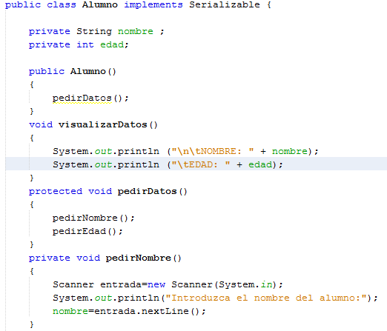
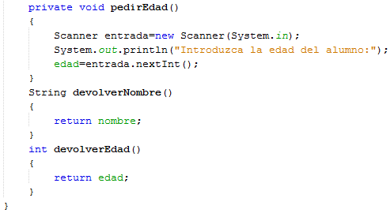
4 Storage of objects in files.
We have to implement the Serializable interface.

Slide 67
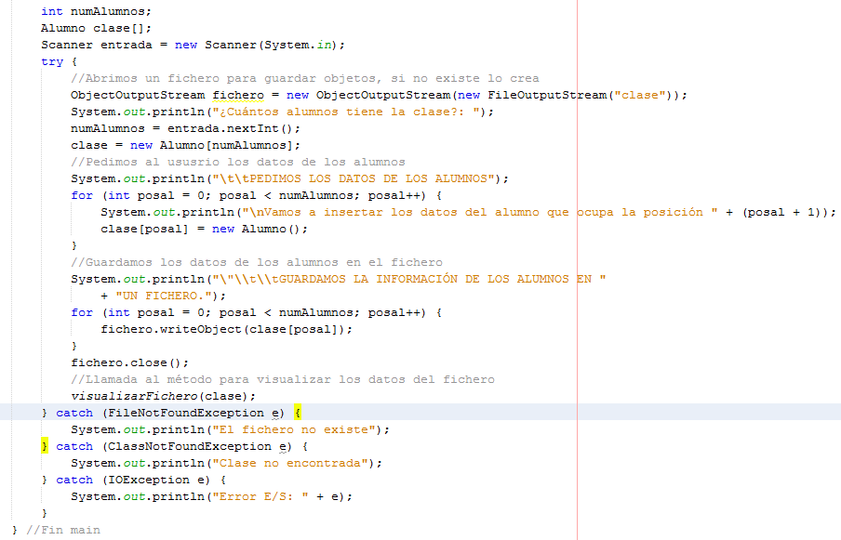
4 Storage of objects in files.

Slide 68
4 Storage of objects in files.
In the method declaration we throw the exceptions IOException, ClassNotFoundException.
The instruction used to open the file ("class" is the name the file will have) is:
ObjectOutputStream file=new ObjectOutputStream(new FileOutputStream("class"));
The instruction we use to save each of the "Student" objects in the file is:
file.writeObject(class[posal]);

Slide 69
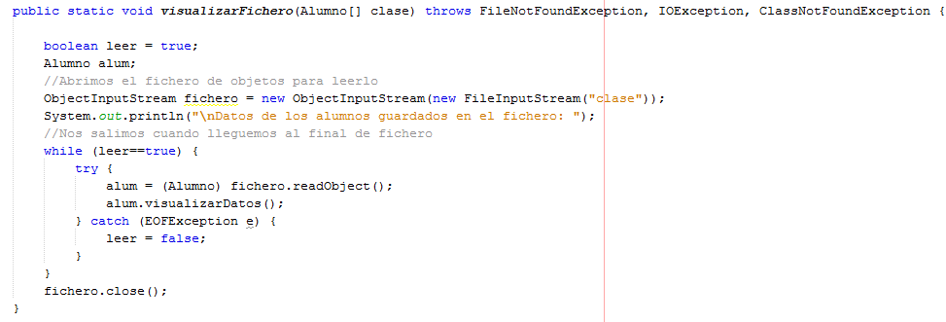
4 Storage of objects in files.

Slide 70
4 Storage of objects in files.
We open the file for reading with the instruction:
ObjectInputStream file = new ObjectInputStream(new FileInputStream("class"));
We read each of the "student" objects with the instruction:
alum=(Student)file.readObject();
To exit the read loop, we catch the exception that occurs when we reach the end of the file and set the "read" variable to false.

Slide 71
4 Storage of objects in files.
Activity 23: Write a program that stores data about the employees of a company in a file. The program will request the number of employees and ask for their data (name, salary, age), then store them in a file. Finally, the program will read the employee data from the file and display it on the screen.

